Slide 1

PLANT SPECIES & LEAF DISEASE CLASSIFICATION
MAJOR PROJECT (BTECH CSE)
Under the guidance of:
Mr. Ayushman Bilas Thakur

Slide 2
INTRODUCTION
Traditionally, farmers have always visually inspected crops. This approach is no longer enough.
Today, there is a clear shift from manual to tech-assisted disease detection.
Deep Learning, especially CNNs, are used for identifying patterns in leaves.
Publicly available datasets play a significant role in training robust models.
Modern innovations like on-device apps, real-time detection, and accessible tools offer fast, field-ready solutions for farmers.

Slide 3
PROBLEM STATEMENT
In the developing world, more than 80 percent of the agricultural production is generated by smallholder farmers.
Yield loss of more than 50% due to pests and diseases are common.
Diseases remain a major threat to this supply, and a large fraction of crops are lost each year to diseases.

Slide 4
SOLUTION
Platform : Web App
Input: User captured image of the infected crop.
Output: the name of the crop and the name of the infected disease

Slide 5
LITERATURE REVIEW
Sl. No. | Title | Author(s) | Approach Used | Contributions / Model Used | Evaluation Metrics
1 | Plant Disease Detection Using Deep Convolutional Neural Network | M. K. R. Reddy, S. P. Kumar, et al. | Custom CNN | Developed a 14-layer CNN (14-DCNN) trained on augmented datasets; converted model to TensorFlow Lite for mobile deployment. | Training Accuracy: 99.993%, Validation Accuracy: 99.985%
2 | Deep Learning-Based Leaf Disease Detection in Crops Using Images for Agricultural Applications | S. Sharma, A. Singh, et al. | Transfer Learning | Fine-tuned pre-trained models (DenseNet-121, ResNet-50, VGG-16, Inception V4) on the PlantVillage dataset; addressed multi-class, multi-label classification challenges. | Accuracy, Sensitivity, Specificity, F1 Score
3 | Using Deep Learning for Image-Based Plant Disease Detection | S. P. Mohanty, D. Hughes, M. Salathé | Custom CNN | Trained a deep CNN on 54,306 images to identify 14 crop species and 26 diseases; demonstrated feasibility of smartphone-assisted disease diagnosis. | Accuracy: 99.35% on test set
4 | Explainable Vision Transformer Enabled Convolutional Neural Network for Plant Disease Identification: PlantXViT | P. S. Thakur, P. Khanna, T. Sheorey, A. Ojha | Vision Transformer + CNN | Proposed PlantXViT, combining CNNs with Vision Transformers; evaluated on five datasets; emphasized model explainability using Grad-CAM and LIME techniques. | Accuracy: >93.55% (Apple), >92.59% (Maize), >98.33% (Rice)
5 | Plant Leaf Disease Detection Using Deep Learning: A Multi-Dataset Approach | K. Meghraoui, I. Sebari, J. Pilz, et al. | Transfer Learning | Employed multiple datasets and deep learning models for robust plant disease detection; addressed challenges in dataset variability and model generalization. | Not specified
6 | Plant Disease Detection Using Image Processing and Machine Learning | P. Kulkarni, A. Karwande, T. Kolhe, S. Kamble, A. Joshi, M. Wyawahare | Machine Learning | Proposed a technique combining image processing with machine learning algorithms for efficient crop disease detection; aimed to reduce reliance on skilled labor. | Not specified
7 | Plant Disease Detection and Classification Using Deep Learning | M. M. Qureshi, M. M. Iqbal, S. Ramzan, S. Majeed, M. S. Bashir | Transfer Learning + Custom CNN | Developed an end-to-end framework for tomato leaf disease identification using both transfer learning and custom CNN architectures; achieved high classification accuracy on unseen samples. | Accuracy: 92% on unseen samples
8 | A Deep Learning Enabled Multi-Class Plant Disease Detection Model Based on Computer Vision | A. F. Fuentes, S. Yoon, S. C. Kim, D. S. Park | Deep Learning | Developed a robust deep learning-based detector for real-time tomato plant diseases and pests recognition; emphasized real-time application and high performance. | Not specified
9 | An open access repository of images on plant health to enable the development of mobile disease diagnostics | David P. Hughes, Marcel Salathé | Dataset / Survey / Other | Developed an open dataset (PlantVillage) for plant disease detection | Not specified
10 | On Using Transfer Learning for Plant Disease Detection | Abhinav Sagar, Dheeba Jacob | Transfer learning | Used pre-trained VGG16 and ResNet architectures for classification | Accuracy, Precision, Recall

Slide 6
OBJECTIVES
Accurately classify plant species from leaf images.
Identify diseases affecting specific species.
Build a deep learning model for multi-class classification.
Leverage pre-trained models.
Contribute to sustainable agriculture.

Slide 7
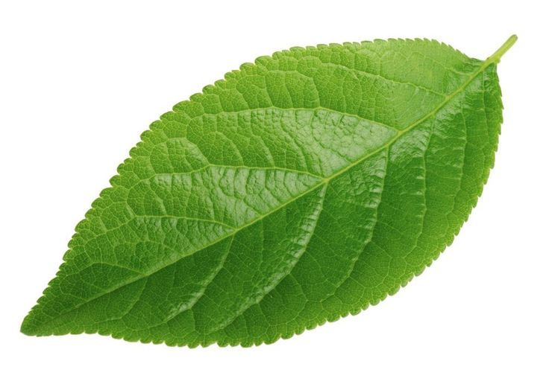

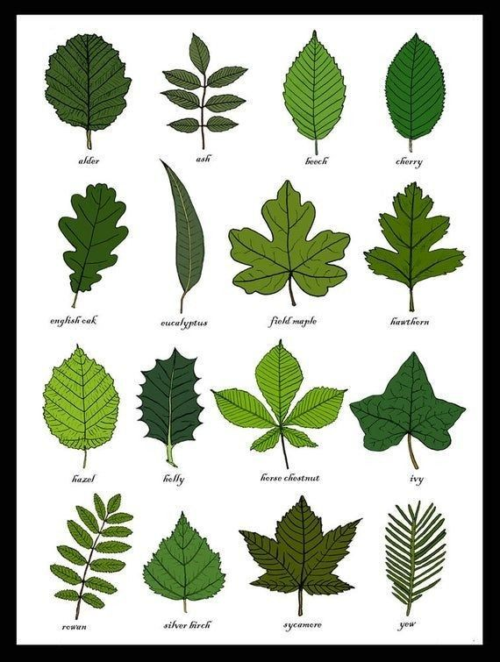
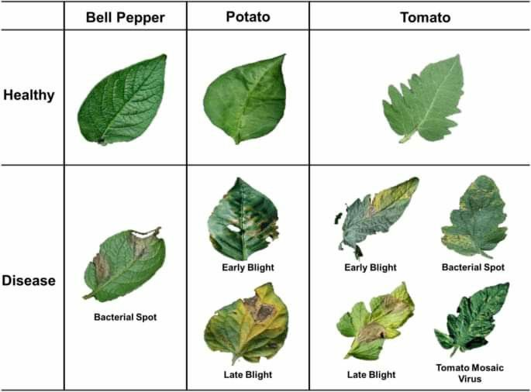
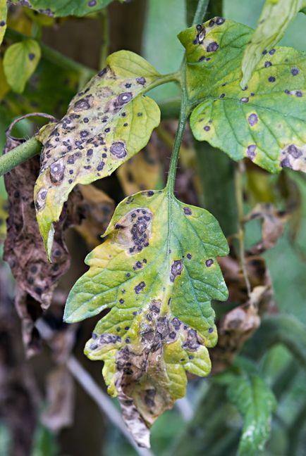
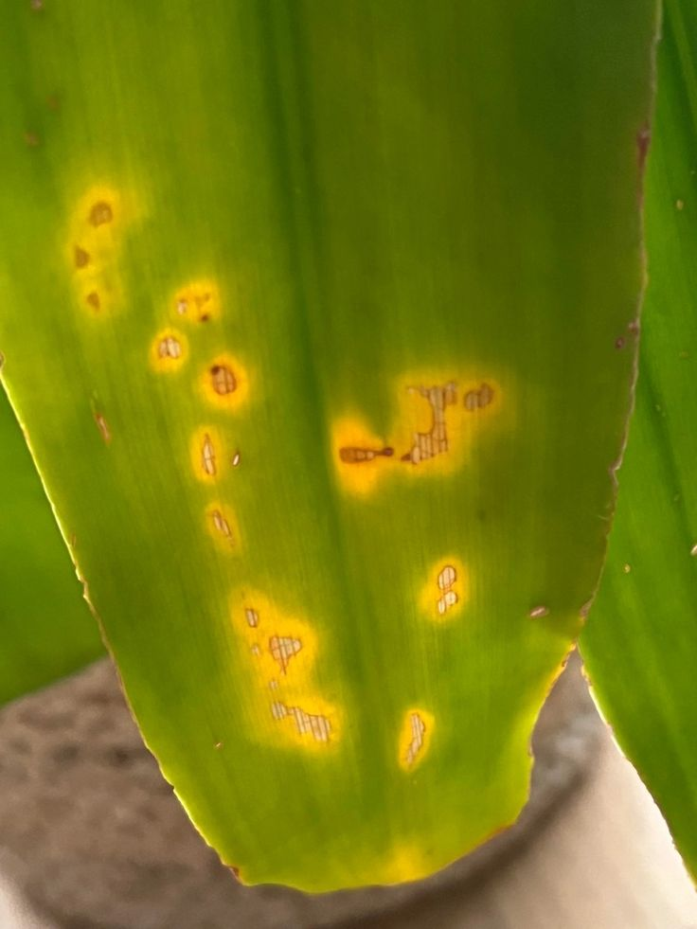
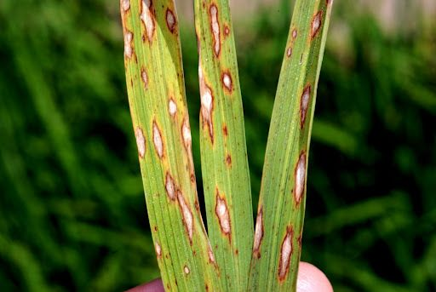
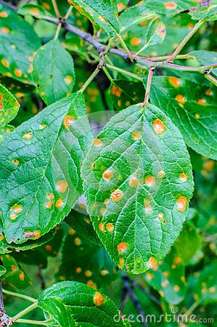
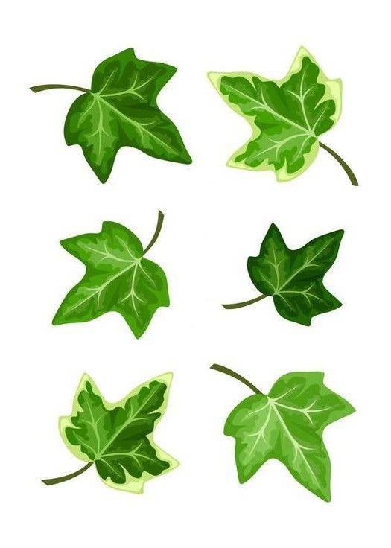
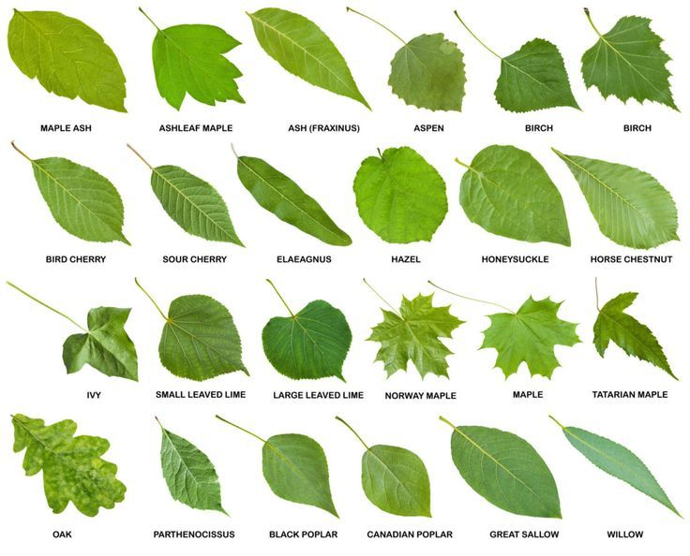
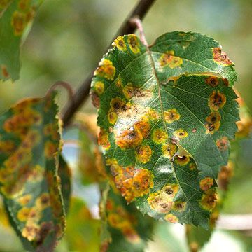
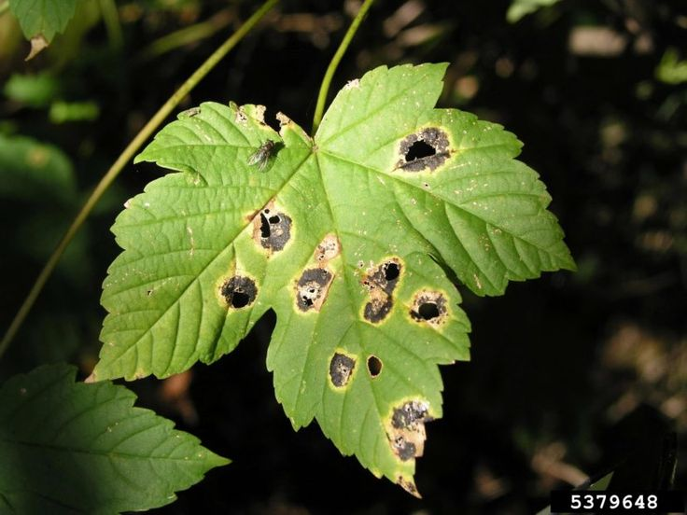

Slide 8

No. | Dataset Name | Source | Type | Image Count | Classes / Species | Purpose / Use-case | Link
1 | PlantVillage (Original) | TensorFlow / Mendeley | Disease Classification | ~54,303 | 38 | Benchmark for plant disease detection | Link
2 | New Plant Diseases Dataset (Customized PV) | Kaggle | Disease Classification | ~87,000 | 38+ | Includes background/noisy variations | Link
3 | Plant Disease Dataset (Customized PV) | Kaggle | Disease Classification | ~54,000 | 38 | Balanced & enhanced version of PlantVillage | Link
4 | UCI Plant Leaf Dataset | UCI | Species Classification | 440 | 30 | Shape-based feature recognition | Link
5 | Pl@ntNet Dataset | Zenodo | Species Identification | ~300,000 | ~10,000+ | Real-world noisy images, species identification | Link
6 | iNaturalist Species Dataset | NA | Species Classification | Millions | Thousands | Species detection in wild | Official Site
7 | One-Hundred Plant Species Leaves Dataset (UCI) | UCI | Species Classification | 1,600 | 100 | Leaf shape-based species recognition | Link
8 | House Plant Species Dataset | Kaggle | Species Classification | ~3,000 | ~50 | Indoor plant recognition | Link
9 | PlantDoc Dataset | NA | Disease Detection in the Wild | ~2,598 | 10+ | Field conditions, real-world testing | PlantDoc GitHub
10 | Paddy Doctor Dataset | NA | Paddy Disease Classification | ~10,000 | 10 | Paddy disease diagnosis | Kaggle Link
11 | Plant Pathology 2020 Challenge Dataset | NA / Kaggle | Apple Leaf Disease Classification | ~3,000 | 4 | Used in FGVC7 Kaggle competition | Kaggle
12 | Mendeley Plant Leaf Disease Dataset | Mendeley | Leaf Disease Detection | ~4,500 | 22 | Benchmark for CNN architectures | Link
13 | AgriNet Dataset | ArXiv / Research Article | Plant Species Classification | ~160,000 | 423 | Crop classification at scale | Link
14 | Plants Type Dataset | Kaggle | Type Classification | ~3,000 | 7 | Herb, Shrub, Tree classification | Link
15 | Mendeley Dataset (v1) | Mendeley | Leaf Disease Classification | Varies | Varies | Disease diagnosis and classification | Link
16 | Mendeley Dataset (v2) | Mendeley | Leaf Disease Classification | Varies | Varies | Dataset extension | Link
17 | Mendeley Dataset (v3) | Mendeley | Leaf Disease Classification | Varies | Varies | Continued version | Link
18 | Mendeley Dataset (v4) | Mendeley | Leaf Disease Classification | Varies | Varies | Final update / version | Link

Slide 9
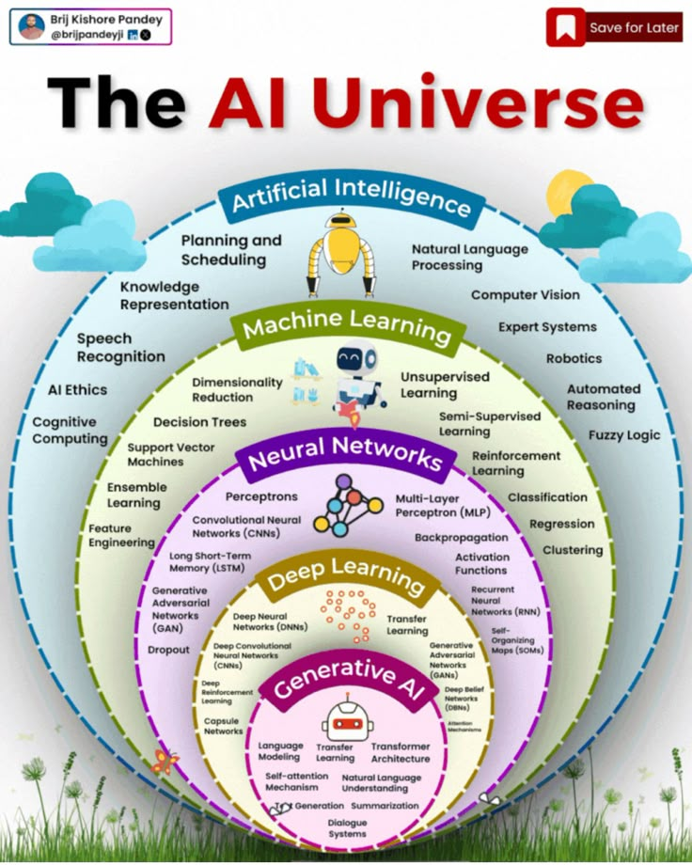

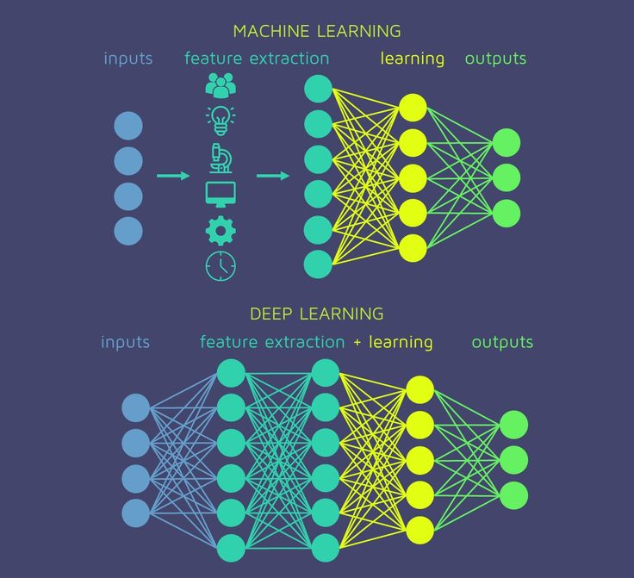

Slide 10
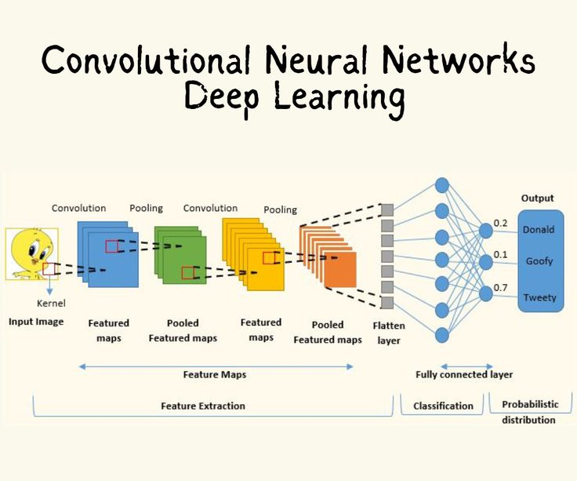
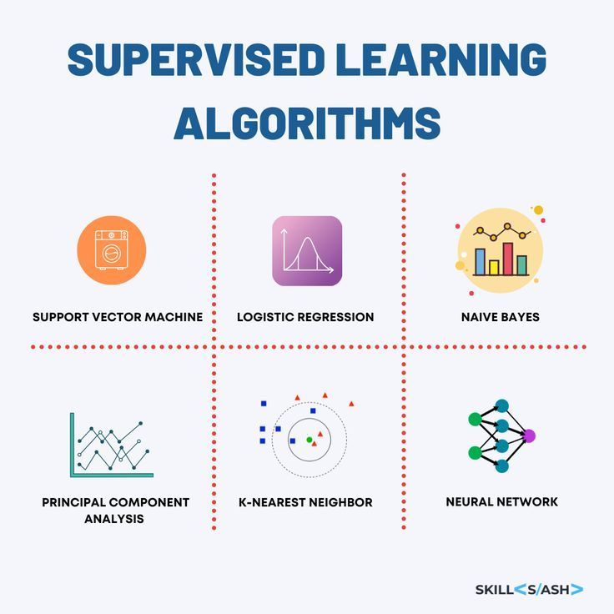
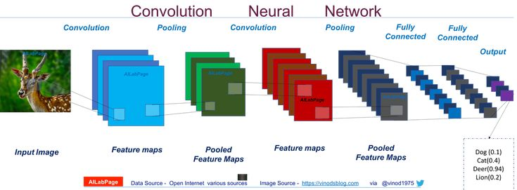

Slide 11
IMPLEMENTATION
To bring our project to life, we trained machine learning models from scratch and also explored transfer learning to boost performance.
Transfer learning helped us save time and resources by using powerful pre-trained models which gave us a strong foundation and allowed our system to recognize plant diseases more accurately, even with a limited dataset.
Dataset
ML Architecture
Model Training
Evaluation

Slide 12
TRANSFER LEARNING BASED MODELS
FOR IMAGE CLASSIFICATION

Slide 13
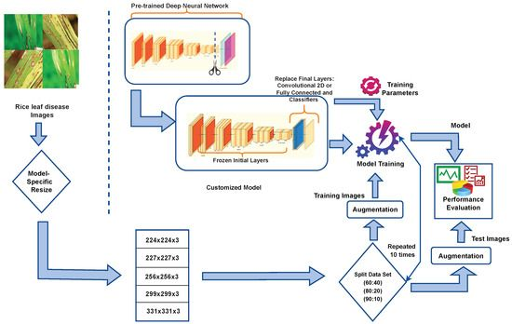

Slide 14
DATASET OVERVIEW
Dataset source: Plant Village Dataset (diseases verified by expert plant pathologists)
The original data records contain around 60,000 images spanning 39 classes.
The images span 14 crop species: Apple, Blueberry, Cherry, Corn, Grape, Orange, Peach, Bell Pepper, Potato, Raspberry, Soybean, Squash, Strawberry, Tomato.
Diseased crop images include 17 fungal diseases, 4 bacterial diseases, 2 mold (oomycete) diseases, 2 viral disease, and 1 disease caused by a mite.
The augmented dataset was split into training, validation, and test sets in a 70-20-10 ratio.

Slide 15
PRE-TRAINED MODELS USED
Model | Type | Purpose
ResNet50 | CNN (50 layers) | Strong base model for classification or feature extraction
MobileNetV2 | Lightweight CNN | Optimized for mobile and edge devices
EfficientNetB0 | Scalable CNN | Balances accuracy and efficiency

Slide 16
MODEL ARCHITECTURE
Component | Model 1: MobileNetV2 | Model 2: EfficientNetB0 | Model 3: ResNet50
Base Architecture | MobileNetV2 | EfficientNetB0 | ResNet50
Pretrained On | ImageNet | ImageNet | ImageNet
Base Trainable? | Frozen | Frozen | Frozen
Input Size | 224 × 224 × 3 | 224 × 224 × 3 | 224 × 224 × 3
Base Output Shape | (7, 7, 1280) | (7, 7, 1280) | (7, 7, 2048)
Global Pooling | GlobalAveragePooling2D | GlobalAveragePooling2D | GlobalAveragePooling2D
Dropout | 0.5 | 0.5 | 0.5
Dense (Output) | 38 units, Softmax | 38 units, Softmax | 38 units, Softmax
Trainable Params | ~48K | ~49K | ~78K
Total Params | ~2.3M | ~5.34M | ~23.66M
Optimizer | Adam (LR=0.001) | Adam (custom LR) | Adam (LR=0.001)
Epochs Trained | 10 | 10 | 10
Strengths | Lightweight, fast inference | Balanced accuracy and efficiency | Deep, high-capacity feature extractor
Use Case Fit | Mobile or low-resource settings | General-purpose, scalable | High-performance, resource-heavy

Slide 17
MODEL TRAINING
Parameter | Value/Details | Explanation
Batch Size | 8 | The number of images processed in one batch during training.
Epochs (Phase 1) | 10 | The number of epochs for training with the frozen base model (feature extraction phase).
Epochs (Phase 2) | 5 (half of Phase 1) | The number of epochs for fine-tuning with the unfrozen base model.
Optimizer | Adam | Default optimizer for training (used with the default learning rate of 0.001).
Learning Rate | 0.001 (default) | The learning rate for the Adam optimizer, which defaults to 0.001 unless changed.
Loss Function | Categorical Cross-Entropy | Used for multi-class classification tasks.
Metrics | Accuracy | The performance metric used during training (measuring classification accuracy).

Slide 18
MODEL EVALUATION
MOBILENETV2
 | precision | recall | f1-score | support
accuracy | 0.938057 | 0.938057 | 0.938057 | 0.938057
macro avg | 0.94199 | 0.92575 | 0.931149 | 6167
weighted avg | 0.942899 | 0.938057 | 0.938238 | 6167
RESNET50
 | precision | recall | f1-score | support
accuracy | 0.994649 | 0.994649 | 0.994649 | 0.994649
macro avg | 0.993209 | 0.995069 | 0.994086 | 6167
weighted avg | 0.994741 | 0.994649 | 0.994654 | 6167
Unfortunately, EfficientNetB0 model did not load successfully even after model training.

Slide 19
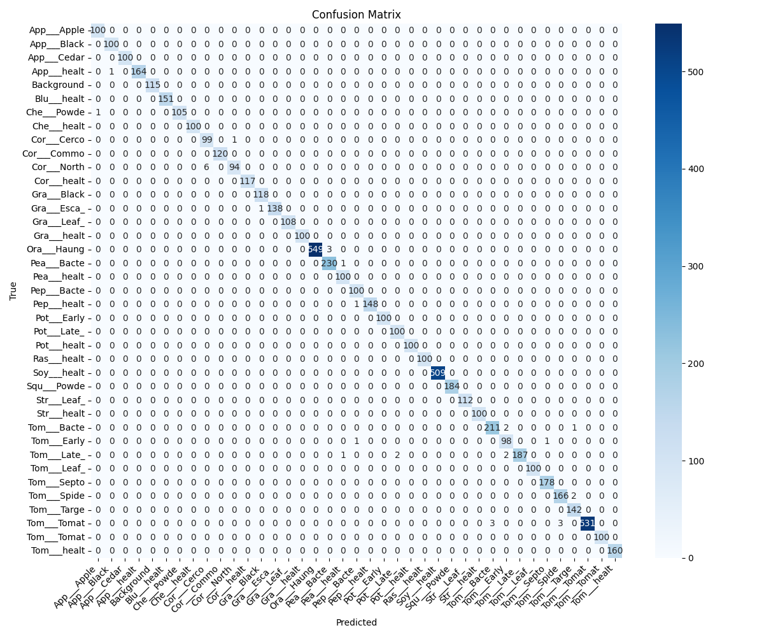
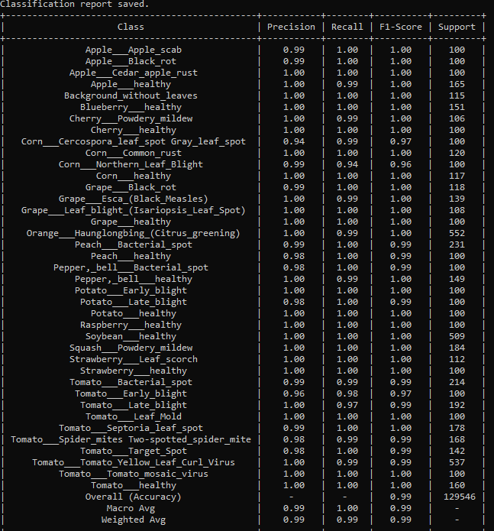
RESNET50
EVALUATION METRICS

Slide 20
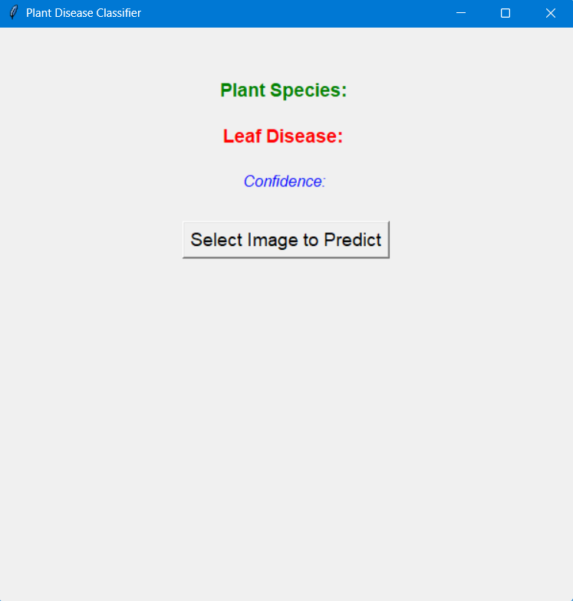
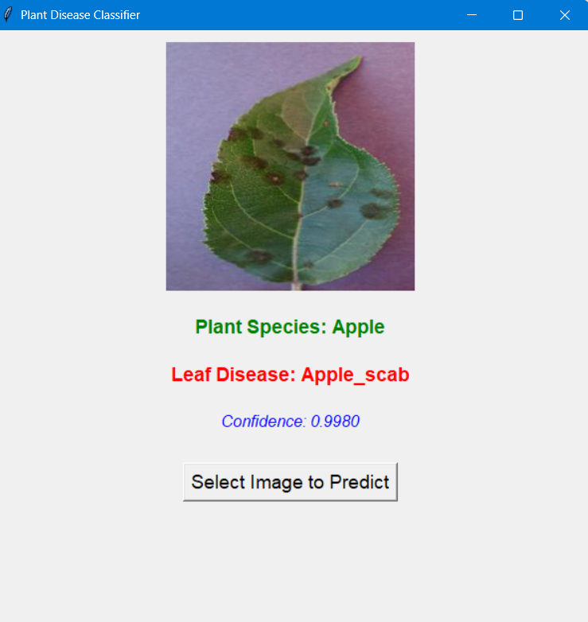
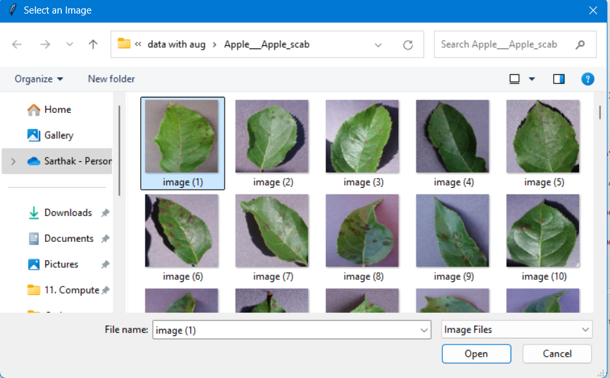
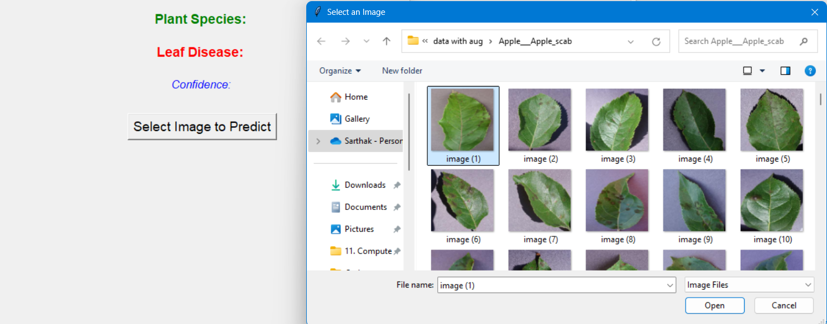
DEPLOYMENT

Slide 21
TRAINING A MODEL FROM SCRATCH
USING TENSORFLOW / PYTORCH

Slide 22
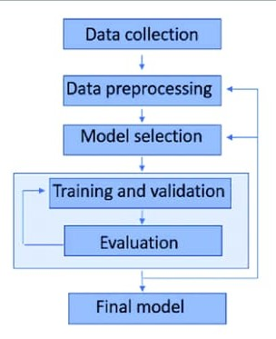


Slide 23
DATASET OVERVIEW
Dataset: Customized Plant Village Dataset (source - Kaggle)
This customized data records contain around 87,000 images spanning 38 classes.
The images span 14 crop species: Apple, Blueberry, Cherry, Corn, Grape, Orange, Peach, Bell Pepper, Potato, Raspberry, Soybean, Squash, Strawberry, Tomato.
The total dataset is divided into 80/20 ratio of training and validation set preserving the directory structure.
Additionally, the dataset is pre-augmented, eliminating the need for manual augmentation during preprocessing.

Slide 24
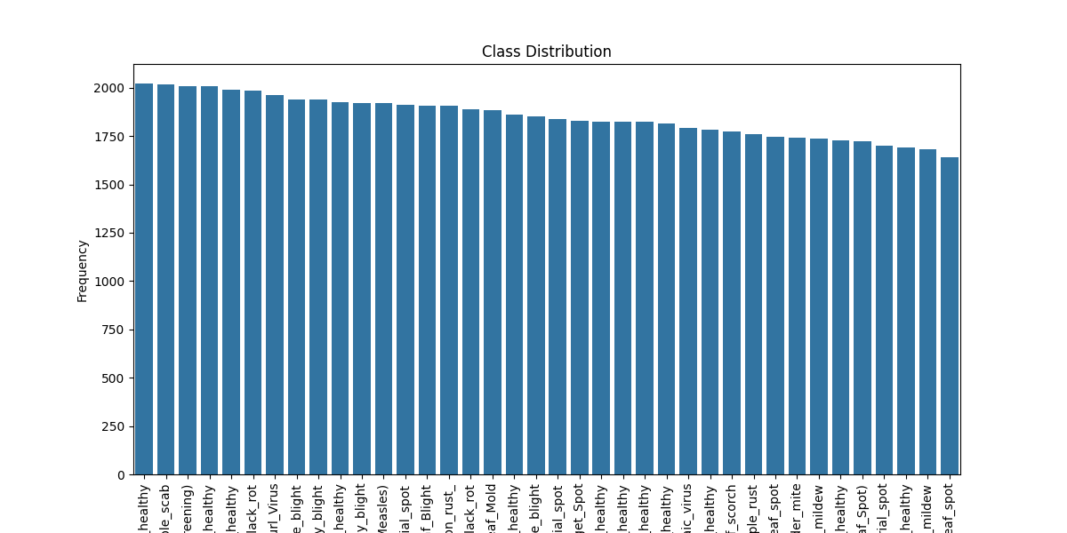
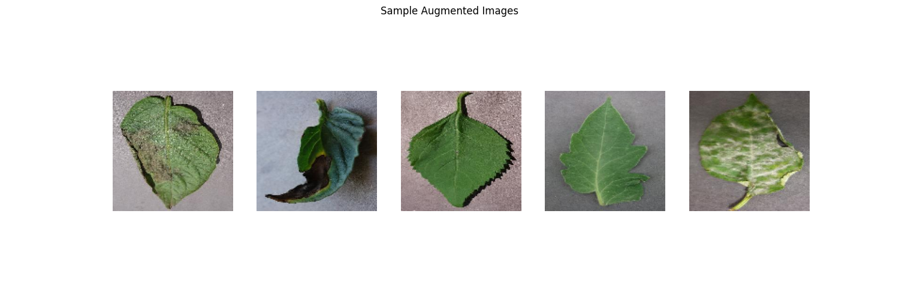
EXPLORATORY DATA ANALYSIS

Slide 25
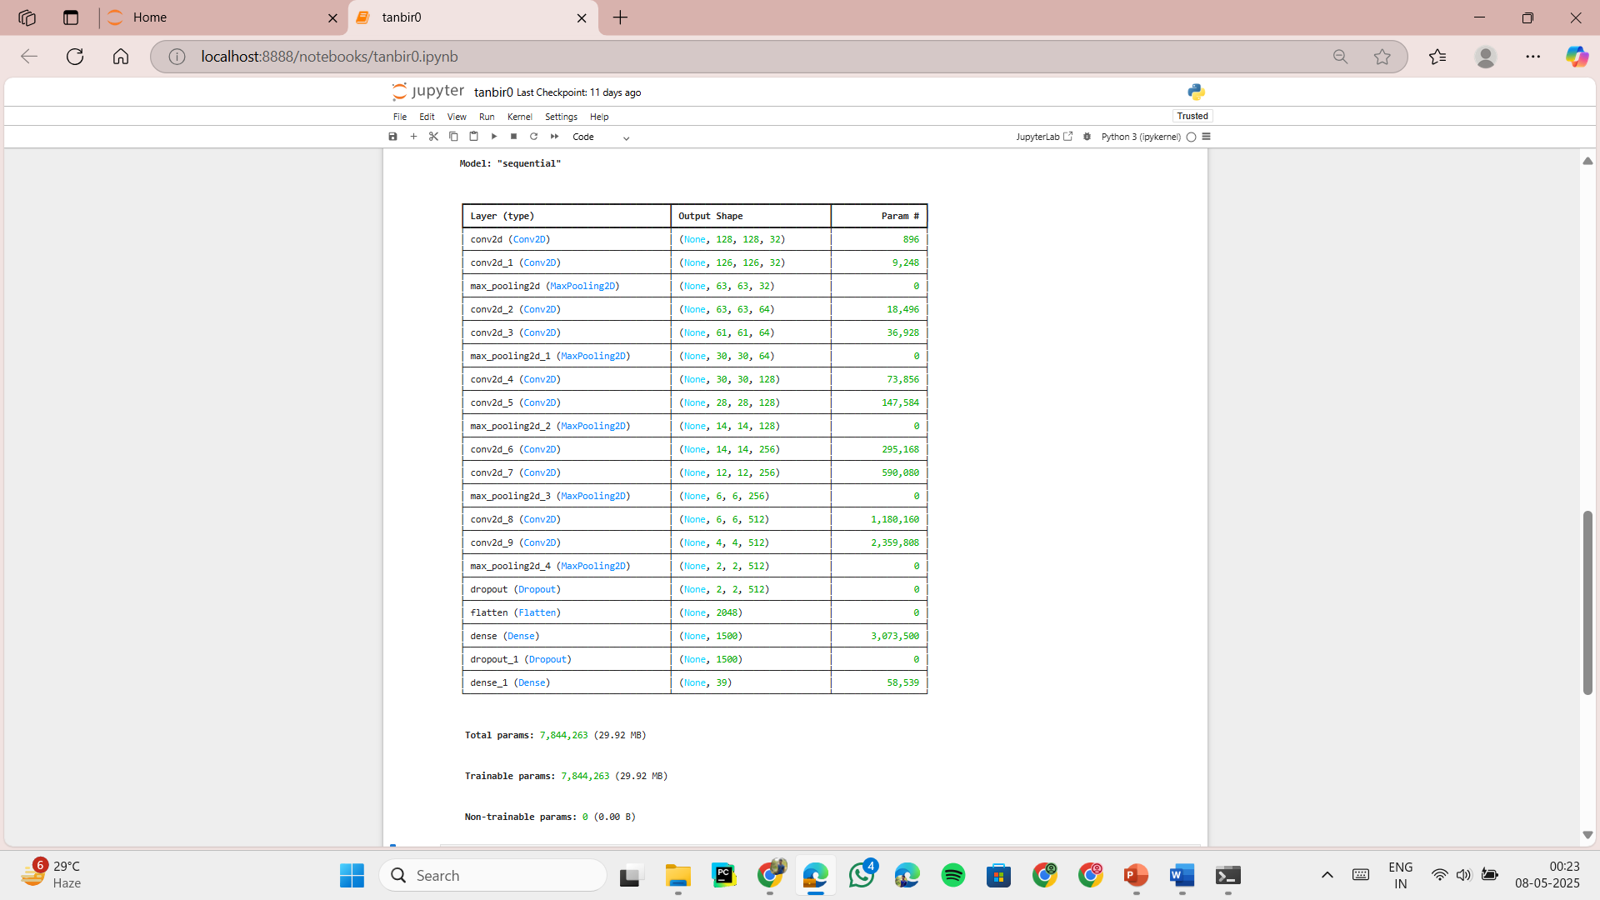
MODEL ARCHITECTURE
Layer # | Type | Output Shape | Filter/Units | Activation | Parameters
1 | Conv2D | (128, 128, 32) | 3×3 | ReLU | 896
2 | Conv2D | (126, 126, 32) | 3×3 | ReLU | 9,248
3 | MaxPooling2D | (63, 63, 32) | 2×2 | — | 0
4 | Conv2D | (63, 63, 64) | 3×3 | ReLU | 18,496
5 | Conv2D | (61, 61, 64) | 3×3 | ReLU | 36,928
6 | MaxPooling2D | (30, 30, 64) | 2×2 | — | 0
7 | Conv2D | (30, 30, 128) | 3×3 | ReLU | 73,856
8 | Conv2D | (28, 28, 128) | 3×3 | ReLU | 147,584
9 | MaxPooling2D | (14, 14, 128) | 2×2 | — | 0
10 | Conv2D | (14, 14, 256) | 3×3 | ReLU | 295,168
11 | Conv2D | (12, 12, 256) | 3×3 | ReLU | 590,080
12 | MaxPooling2D | (6, 6, 256) | 2×2 | — | 0
13 | Conv2D | (6, 6, 512) | 3×3 | ReLU | 1,180,160
14 | Conv2D | (4, 4, 512) | 3×3 | ReLU | 2,359,808
15 | MaxPooling2D | (2, 2, 512) | 2×2 | — | 0
16 | Dropout | (2, 2, 512) | — | — | 0
17 | Flatten | (2048) | — | — | 0
18 | Dense | (1500) | 1500 | ReLU | 3,073,500
19 | Dropout | (1500) | — | — | 0
20 | Dense (Output) | (38) | 38 | Softmax | 57,038

Slide 26
TRAINING AND EVALUATION
Component | Details
Batch Size | 32
Epochs | 10
Optimizer | Adam (learning rate = 0.0001)
Loss Function | Categorical Crossentropy
Metrics | Accuracy
Validation | Used during training
Regularization | Dropout (0.25 + 0.4)
Augmentation | Yes

Slide 27
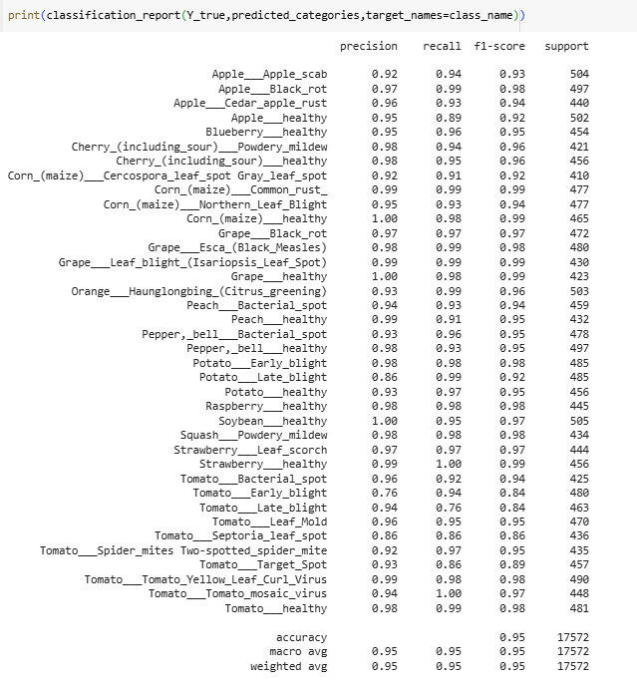
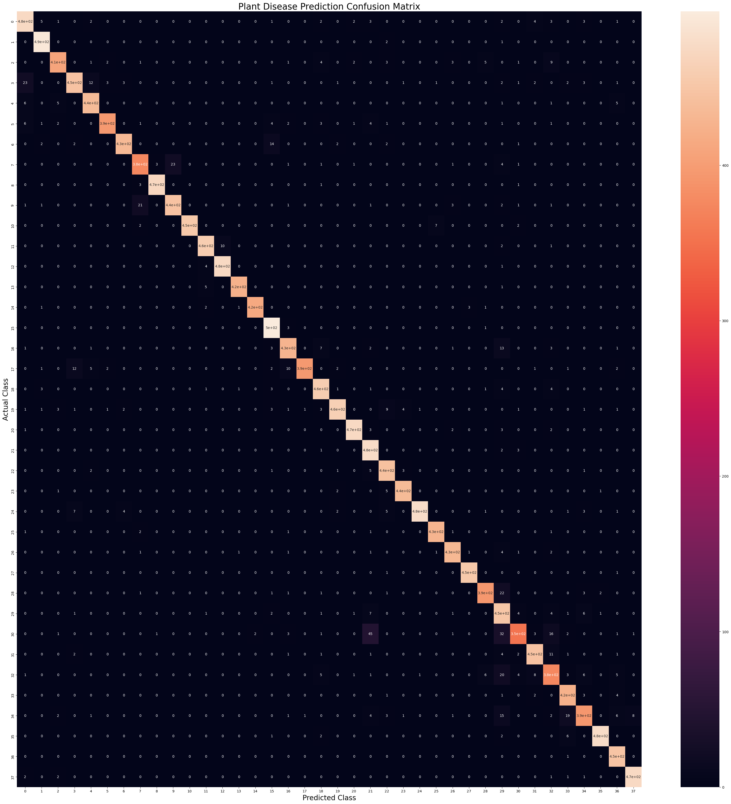
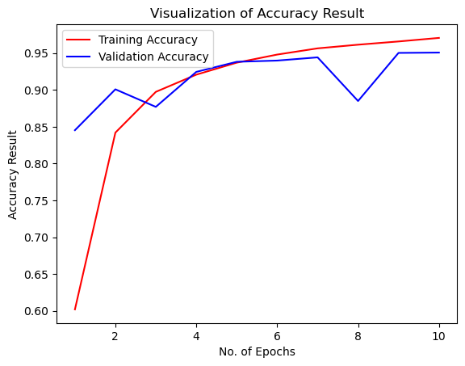

Slide 28
DEPLOYMENT

Slide 29
CHALLENGES
Limited hardware: slow training due to lack of GPU
Class imbalance affecting performance
Overfitting and overshooting during training
Poor confusion matrix alignment (vertical patterns)
Insufficient annotated datasets
Time-consuming Exploratory Data Analysis

Slide 30
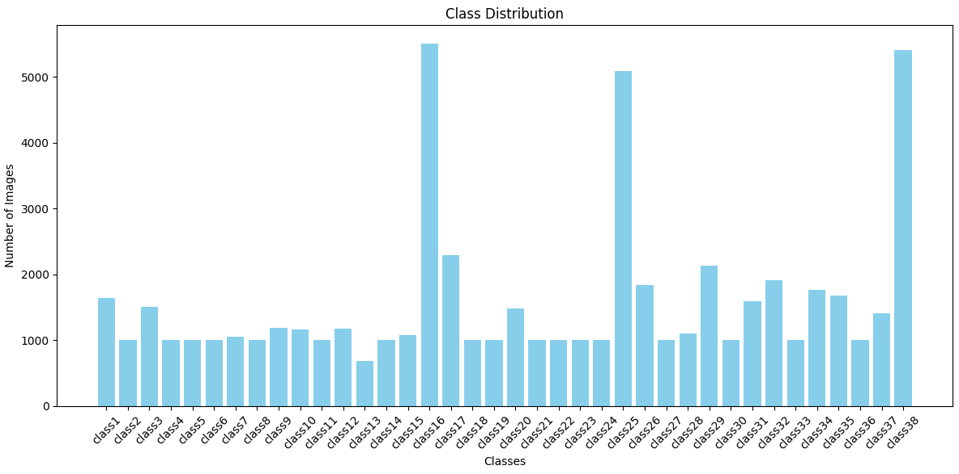
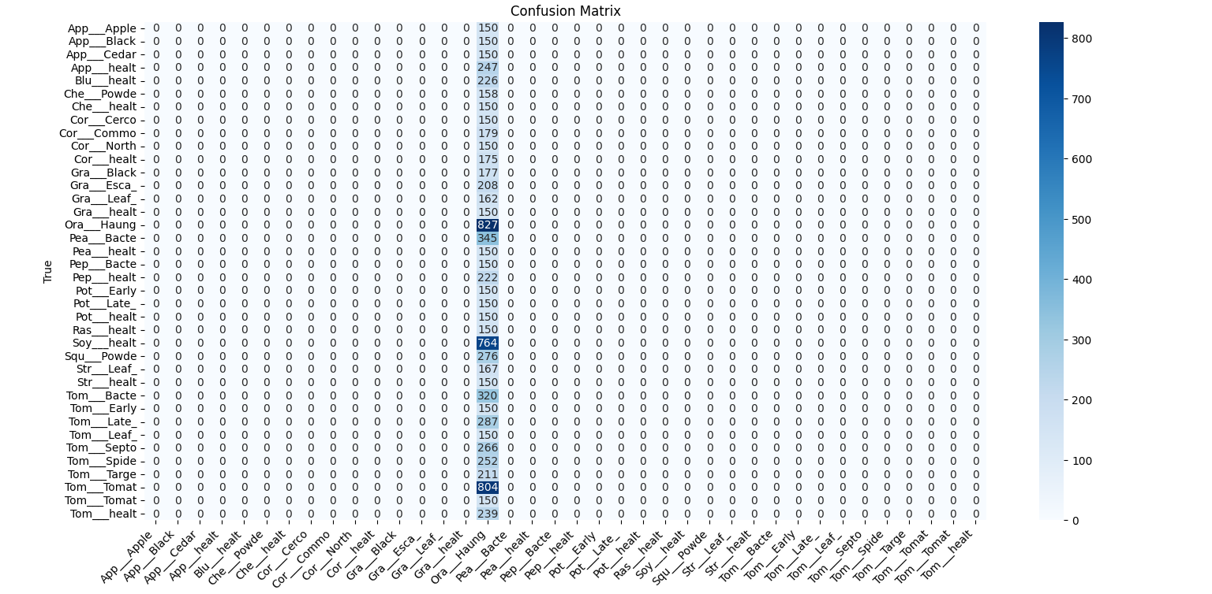
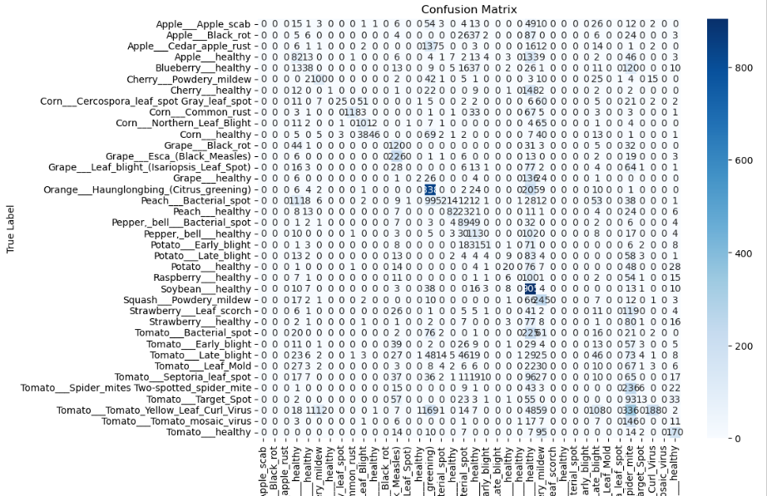

Slide 31
LEARNINGS
Tacking imbalance with undersampling/oversampling
Importance of data augmentation and regularization
Applying K-Fold Cross Validation for robust evaluation
Power and efficiency of transfer learning
Understanding evaluation metrics beyond accuracy
Impact of proper preprocessing on model performance

Slide 32
FUTURE WORK
Expand Dataset: Include more plant species and disease categories
Real-Time Detection: Enable live prediction via camera input
IoT Integration: Connect with smart farming systems for automated alerts
Language Accessibility: Develop a multilingual blog for farmers to share infected crop images and collaborate on solutions
Drone-based Monitoring: Use drones for real-time, in-field classification and plant population analysis
Advanced Detection Models: Explore fully convolutional networks for specific pests like rice planthoppers

Slide 33
FUTURE WORK (TRANSFER LEARNING APPROACH)
Model Name | Input Size | # Parameters (Approx) | Pretrained Dataset | Original Classes | Notes | Docs Link
EfficientNetB0 | 224×224 | 5.3 million | ImageNet | 1000 | Lightweight, accurate | EfficientNetB0
EfficientNetB1 | 224×224 | 7.8 million | ImageNet | 1000 | Slightly heavier than B0 | EfficientNetB1
EfficientNetV2S | 384×384 | 21.5 million | ImageNet21k/1k | 1000 | You can resize to 224 if memory-constrained | EfficientNetV2S
MobileNetV2 | 224×224 | 3.4 million | ImageNet | 1000 | Very efficient, good on low compute | MobileNetV2
MobileNetV3Small | 224×224 | 2.5 million | ImageNet | 1000 | Add alpha=1.0, small and fast | MobileNetV3Small
ResNet50 | 224×224 | 25.6 million | ImageNet | 1000 | Heavy, accurate | ResNet50
ResNet101 | 224×224 | 44.7 million | ImageNet | 1000 | Heavier than ResNet50 | ResNet101
DenseNet121 | 224×224 | 8.1 million | ImageNet | 1000 | Dense connections, good for fine details | DenseNet121
InceptionV3 | 299×299 | 23.8 million | ImageNet | 1000 | Needs higher input size, use only if GPU allows | InceptionV3
NASNetMobile | 224×224 | 5.3 million | ImageNet | 1000 | Lightweight NAS-optimized model | NASNetMobile
Xception | 299×299 | 22.9 million | ImageNet | 1000 | Depthwise separable convolutions, needs higher input size | Xception
VGG16 | 224×224 | 138 million | ImageNet | 1000 | Very heavy, but still good for transfer learning | VGG16
MODEL OVERVIEW AND SPECIFICATIONS

Slide 34
FUTURE WORK
Model Name | Phase 1 Time per Epoch (sec) | Phase 2 Time per Epoch (sec) | Total Time per Fold (min) | Total Time for 5 Folds (hr) | Notes
EfficientNetB0 | 200 (after first) | 600 | ~87.5 | 7.3 | Measured baseline
EfficientNetB1 | 230 | 700 | ~100 | 8.3 | Slightly larger than B0
EfficientNetV2S | 500 | 900 | ~220 | 18.3 | Large input size (384+)
MobileNetV2 | 140 | 300 | ~60 | 5.0 | Lightweight
MobileNetV3Small | 130 | 270 | ~55 | 4.6 | Very small, fast
ResNet50 | 300 | 700 | ~130 | 10.8 | Heavy backbone
ResNet101 | 400 | 900 | ~175 | 14.6 | Very deep
DenseNet121 | 270 | 650 | ~150 | 12.5 | Dense connections
InceptionV3 | 420 | 850 | ~190 | 15.8 | Needs 299×299 input
NASNetMobile | 250 | 500 | ~115 | 9.6 | NAS-designed
Xception | 450 | 900 | ~200 | 16.7 | Needs 299×299 input
VGG16 | 400 | 900 | ~175 | 14.6 | Very heavy (138M params)
EXPECTED TRAINING PERFORMANCE (PHASE 1 AND PHASE 2)

Slide 35
GROUP MEMBERS & TEAM GUIDE
Sarthak Shah (UG/02/BTCSE/2021/021)
Tanbir Saha (UG/02/BTCSEAIML/2021/013)
Mr. Ayushman Bilas Thakur
Assistant Professor
Department of CSE
Adamas University
Team guide :
THANK YOU!

